Slide 1
Electromagnetic Waves

Slide 2
Jag Mark
Electromagnetic Waves can transfer energy without
A medium
An electric field
A magnetic field
A change in either a magnetic or an electric field
Which statement BEST describes how electromagnetic waves differ from other types of waves?
They can travel in a straight line
They have speed but no frequency
They have wavelength but no energy
They can travel through a vacuum

Slide 3
What Are EM Waves?
Electromagnetic Waves: made by vibrating electric charges and can travel through space and matter by transferring energy between vibrating electric and magnetic fields.

Slide 4
Radiation – emission of energy in the electromagnetic wave.

Slide 5
EM waves radiate in all directions, but the diagram only shows one direction.

Slide 6
EM waves can transfer energy without a medium

Slide 7
The Particle-Wave Theory of Light Optional Video
The idea that light can behave as particles (photons) and as waves.

Slide 8
Photon – a tiny packet of energy released when electrons move in and out of their orbits around the nucleus of an atom.

Slide 9
When thought of as a wave, EM waves are transverse waves that are made of changing electric and magnetic fields. These electric and magnetic fields are at right angles to each other.

Slide 10
How are they produced?
Electric and magnetic fields are constantly changing
EM waves are produced when electric charges vibrate or accelerate

Slide 11
How do they travel?
Since electric and magnetic fields are constantly changing, they regenerate each other
EM waves can travel through a vacuum (empty space) as well as through matter.

Slide 12
Speed
All EM waves travel 300,000 km/sec in space. (The speed of light → nature’s limit!)
EM waves usually travel slowest in solids and fastest in gases.

Slide 13
The Electromagnetic Spectrum
NASA video

Slide 14
Electromagnetic Spectrum: arrangement of electromagnetic waves in order of wavelength and frequency.

Slide 15
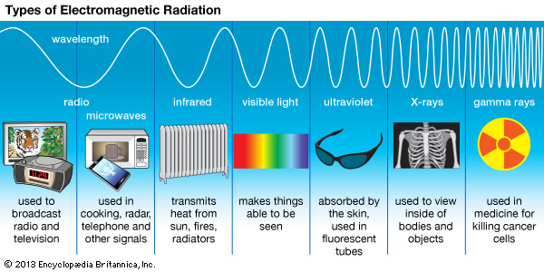

Slide 16
The EM Spectrum
The frequency of electromagnetic waves is the number of vibrations per second (Hertz).
As frequency increases, wavelength becomes smaller.

Slide 17
Radio waves – EM waves with the longest wavelength and lowest frequency. Infrared Waves – EM wave in the frequency range just below visible light; felt as heat. Visible Light – Range of EM waves you can detect with your eyes. Ultraviolet Waves – EM wave in the frequency region just above visible light. X Rays – EM wave in the frequency range just above UV rays. Gamma rays – EM waves with the highest frequency and the shortest wavelength.

Slide 18
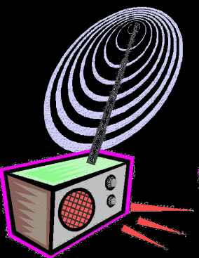
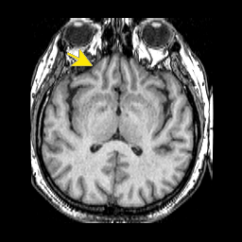
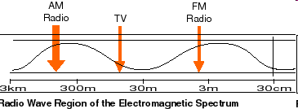
Radio waves
Longest wavelength EM waves
Uses:
TV broadcasting
AM and FM broadcast radio
Heart rate monitors
Cell phone communication
MRI (MAGNETIC RESONACE IMAGING)
Uses Short wave radio waves with a magnet to create an image
Notes:
Uses: radio and television broadcasts
Wavelength and Frequency: longest wavelength and lowest frequency.
Emitted by: astronomical objects, radio station transmitters
Detected by: antennae of a radio/radio telescopes
Size: range from the length of a football to larger than our planet.
Other Effects: A radio receives radio waves and then converts them into an electric current, which is then converted to sound.

Slide 19
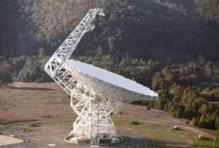
Radio (Longest electromagnetic waves)
Emitted by
Astronomical Objects
Radio Station Transmitters
Detected by
Ground based radio telescopes
*If you turn on a radio,, it will convert the radio wave energy into sound energy.

Slide 20
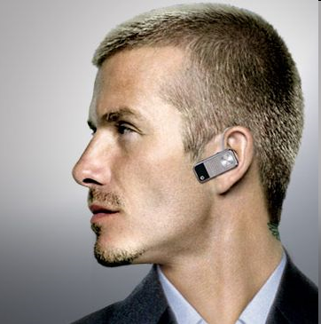
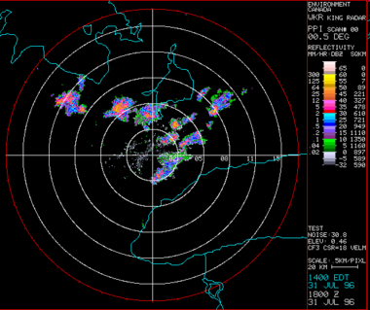
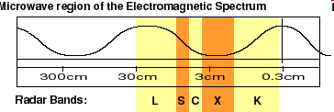
Microwaves
Wavelengths from 1 mm- 1 m
Uses:
Microwave ovens
Bluetooth headsets
Broadband Wireless Internet
Radar
GPS
Notes:
Radio waves with shorter wavelengths and higher frequency than radio waves so they carry more energy than radio waves.
Uses: cooking, radar, telephone and other signals
Emitted by: gas clouds collapsing into stars, microwave ovens, radar stations, cell phones
Detected by: Microwave telescopes, food (heated), cell phones, radar (systems)
Size: as small as a butterfly or as large as a human

Slide 21
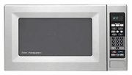
Microwave
Emitted by:
Gas clouds collapsing into stars
Microwave Ovens
Radar Stations
Cell Phones
Detected by
Microwave Telescopes
Food (heated)
Cell phones
Radar (systems)

Slide 22
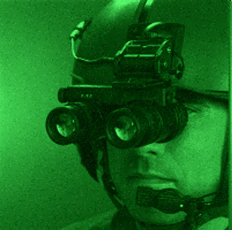
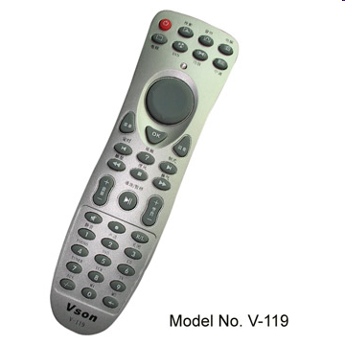
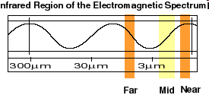
Infrared Radiation
Wavelengths in between microwaves and visible light
Uses:
Night vision goggles
Remote controls
Heat-seeking missiles
Notes:
Anything that gives off heat.
Uses: transmits heat from sun, fires, and radiators; cooking
Emitted by: sun and stars, TV remote controls, food warming lights
Detected by: infrared cameras/ goggles, TVs, VCRs, your skin
Size: small as a pinpoint
Other Effects: When you sit outside on a sunny day, you feel warm because of infrared waves emitted by the sun. Stars, planets, buildings, trees, and you all emit infrared waves. The amount of infrared waves an object emits depends on the objects temperature.

Slide 23
Infrared (Heat or Thermal) Are you a source of infrared? YES you are!
Emitted by
Sun and stars (Near)
TV Remote Controls
Food Warming Lights (Thermal)
*Everything at room temperature or above,=HEAT
Detected by
Infrared Cameras
TVs, VCRs,
Your skin

Slide 24
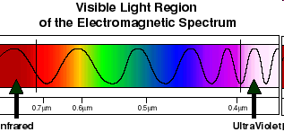
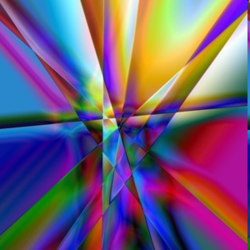
Visible light
Only type of EM wave able to be detected by the human eye
Violet is the highest frequency light
Red light is the lowest frequency light
Notes:
Visible light is the very narrow range of wavelength and frequencies in the electromagnetic spectrum that humans can see.
ROY G. BIV
Uses: makes things able to be seen
Emitted by: Stars, sun, fireflies, lightbulbs
Detected by: human eye
Size: small as protozoans
The longest waves are seen as red and the shortest are seen as violet. Because violet is the shortest wavelength, it carries the most energy.

Slide 25
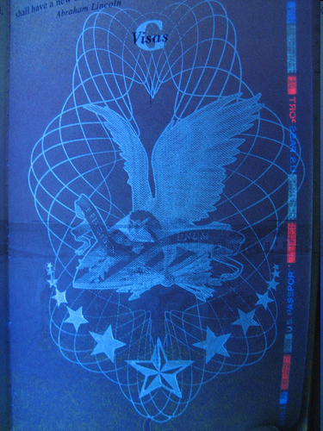
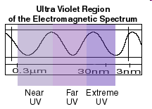
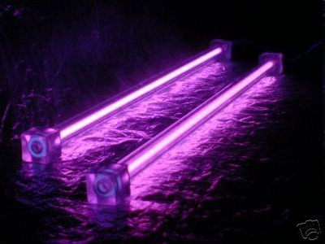
Ultraviolet
Shorter wavelengths than visible light
Uses:
Black lights
Security images on money
Harmful to living things
Used to sterilize medical equipment
Too much causes sun burn
Extremely high exposure can cause skin cancer
Notes:
shorter wavelength and higher frequency than visible light
Uses: Kills bacteria in food and surgical instruments, also limited exposure allows your body to produce vitamin D, necessary for absorption of calcium by intestines. Without calcium, your bones and teeth would be very weak.
Emitted by: sun, hot objects in space
Detected by: spectrometers, radiometers
Dangers: sunburn/cancer
Size: molecule
Easily blocked by clothing

Slide 26
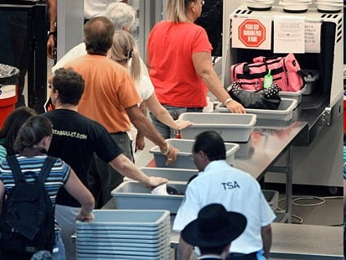
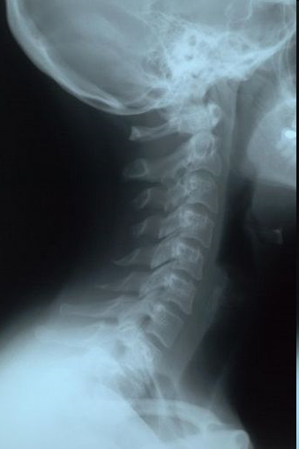
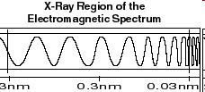
X-rays
Tiny wavelength, high
energy waves
Uses:
Medical imaging
Airport security
Moderate dose can be damaging to cells
Notes:
They have enough energy to pass through soft tissues such as skin but not enough to pass through bones and teeth
Uses: to view inside of bodies and objects
Emitted by: radioactive materials, generated by machines in medicine and industry
Detected by: fluoroscopy (AKA: x-ray movie), photographic plates, fluorescent screens
Danger: can cause cancer
Size: small as an atom

Slide 27
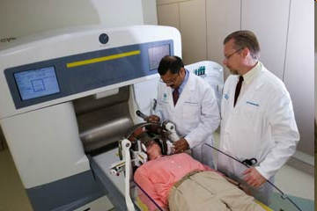
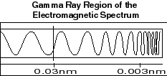
Gamma Rays
Smallest wavelengths, highest energy EM waves
Uses
Sterilizes medical equipment
Cancer treatment to kill cancer cells
Kills nearly all living cells.
Notes:
Shortest Wavelength, highest frequency
Gamma rays have enough energy to go through most materials easily; you would need a 3-4 ft thick concrete wall to stop them!
Uses: used in medicine for killing cancer, Sterilizes medical equipment
Emitted by: nucleus of an atom, universe
Detected by: Size: as small as atomic nuclei
Danger: Can destroy healthy tissue

Slide 28
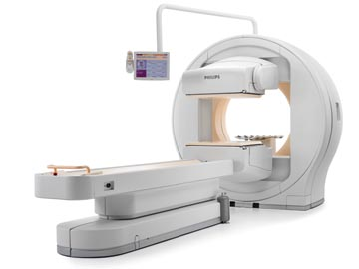
Gamma Rays
-Shortest wavelength
-Highest frequency
Gamma rays are used in the medical field to kill cancer cells and to make pictures of the brain & in industrial situations as an inspection tool.

